Slide 1
Session 15 String Buffer & String Tokenizer & Calendar class

Slide 2
Outcomes
Students will be able to understand difference between String and StringBuffer
Usage of StringTokenizer class
Usage Calendar class

Slide 3
Agenda
StringBuffer
String vs StringBuffer and Mutable vs Immutable
String Constant Pool
StringBuffer Constructor
Methods of StringBuffer
Examples
StringTokenizer
StringTokenizer Constructor
Methods of StringTokenizer
Examples
Calendar
Calendar Instance
Methods of Calendar
Examples

Slide 4
Why StringBuffer?
Once a String object is created it cannot be changed. Strings are Immutable.
To get changeable strings we use the class called StringBuffer.
String and StringBuffer classes are declared as final class, so there cannot be subclasses of these classes.
The default constructor creates an empty string.
String s = new String();

Slide 5
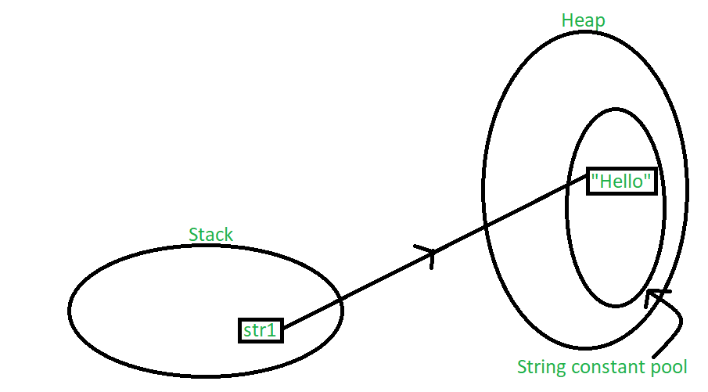
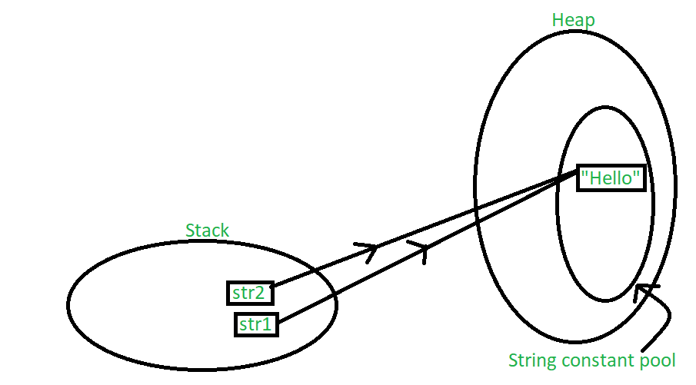
Heap & String Constant Pool
String str1 = "Hello";
String str1 = "Hello";
String str2 = "Hello";

Slide 6
StringBuffer Constructor
Similar to String class but it is mutable (changeable).
Constructors:
//Creates a StringBuffer with empty content and 16 reserved characters by default
StringBuffer sb = new StringBuffer();
// Creates a StringBuffer with the passed argument as the size of the empty buffer.
StringBuffer sb = new StringBuffer(20);
// Creates a StringBuffer with the passed String as the initial content of the buffer. 16 contingent memory characters are pre-allocated
StringBuffer sb = new StringBuffer("Hello World!");

Slide 7
Mutable vs Immutable
StringBuffer sb = new StringBuffer(“klu”);
sb = “kl University”; //error
sb.append(“kl University”); //ok

Slide 8
Difference between String and StringBuffer
THIS IS TEXT
No. | String | StringBuffer
1) | String class is immutable. | StringBuffer class is mutable.
2) | String is slow and consumes more memory when you concat too many strings because every time it creates new instance. | StringBuffer is fast and consumes less memory when you cancat strings.
3) | String class overrides the equals() method of Object class. So you can compare the contents of two strings by equals() method. | StringBuffer class doesn't override the equals() method of Object class.

Slide 9
StringBuffer Operations
delete() - This method is used to delete specified substring within the StringBuffer object
public StringBuffer delete(int start, int end)
replace() - This method is used to replace part of this StringBuffer(substring) with another substring
public StringBuffer replace(int start, int end, String str)
substring() - This method returns a new string which is actually a substring of this StringBuffer. It extracts characters starting from the specified index all the way till the end of the StringBuffer.
reverse() - As the name suggests, the character sequence is reversed with this method
public StringBuffer reverse()
length() – Used to find the length of the StringBuffer
public int length()
public String substring(int start)

Slide 10
StringBuffer Operations
capacity() – We can find the capacity of the StringBuffer using this method
What is capacity ?
The capacity is the amount of storage available for the characters that have just been inserted
public int capacity()
charAt() - Used to find the character at a particular index position
public char charAt(int index)

Slide 11
class FullName{ public static void main(String[] args){
StringBuffer sb=new StringBuffer(); String surname="Mallapudi"; String lastname="vijaya"; sb.append(surname);
System.out.println("Name: "+sb); int n=surname.length(); sb.insert(n,lastname); System.out.println("Full name: "+sb);
System.out.println("In reverse = "+sb.reverse());
}
}

Slide 12
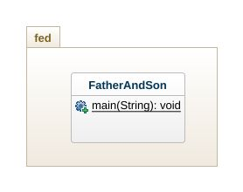
Example 1
Write a Java class FatherAndSon create mutable string Father Name and generate Son Name using surname Father Name. Ensure to use mutable string and its methods.

Slide 13
package fed;
public class FatherAndSon {
private StringBuffer father;
private StringBuffer son;
public static void main(String[] args) {
father = new StringBuffer("James Potter");
son = father.replace(0, father.indexOf(" "), "Harry");
System.out.println(son);
}
}

Slide 14
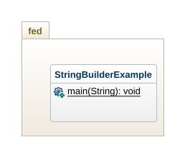
Example 2
Write a Java class StringBuilderExample , create a mutable string with value “Hello World ” print its size and capacity. Use append() and insert() to append previous year followed by a space and ”Welcome to XXXX” where XXXX is current year.

Slide 15
package fed;
public class StringBufferExample {
public static void main(String[] args) {
StringBuffer sb = new StringBuffer("Hello World ");
int sbLength = sb.length();
int sbCapacity = sb.capacity();
System.out.println("String Length of " + sb + " is " + sbLength); System.out.println("Capacity of " + sb + " is " + sbCapacity);
sb.append(2020);
System.out.println(sb);
sb.insert(5, " ");
sb.insert(sb.length(), “ Welcome to 2021”);
System.out.println(sb);
}
}

Slide 16
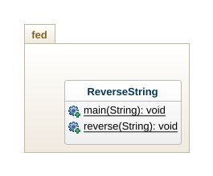
Example 3
Write a Java class ReverseString with a method reverse(String) which prints the string in reverse.

Slide 17
public class Main {
public static void main(String args[]){
String str = new String("KL University");
reverse(str);
}
public static void reverse(String str){
char [] arr = str.toCharArray();
int start, end;
end = arr.length-1;
for(start=0; start<end; start++, end--){
char ch = arr[start];
arr[start] = arr[end];
arr[end] = ch;
}
for( char ch: arr)
System.out.print(ch);
}
}

Slide 18
StringTokenizer class
StringTokenizer class is part of java.util package
The string tokenizer class breaks a string into tokens and returns the tokens.
Tokens can be defined according to delimiter.
Delimiters are the characters that separate tokens.
i.e Suppose we have the string “the day is Friday, the week is the third, the year is 2008”
If we define the delimiter to be the character comma (,)
then we have the following tokens:
1st token: “the day is Friday”
2nd token: “the week is the third”
3rd token: “the year is 2008”

Slide 19
StringTokenizer Constructors
public StringTokenizer(String str)
Constructs a string tokenizer for the specified string.
The tokenizer uses the default delimiter set, which is " \t\n\r\f": the space character, the tab character, the newline character, the carriage-return character, and the form-feed character.
Delimiter characters themselves will not be treated as tokens.
Parameters:str - a string to be parsed.

Slide 20
StringTokenizer Constructors
Another StringTokenizer constructor:
public StringTokenizer(String str, String delim)
Constructs a string tokenizer for the specified string.
The characters in the delim argument is the delimiter for separating tokens.
Delimiter characters themselves will not be treated as tokens.
Parameters:str - a string to be parsed.delim - the delimiters.

Slide 21
Methods of StringTokenizer
public boolean hasMoreTokens() Tests if there are more tokens available from this tokenizer's string.
If this method returns true, then a subsequent call to nextToken with no argument will successfully return a token.
Returns:true if and only if there is at least one token in the string after the current position; false otherwise.
We will use this method within an if structure as a condition to be evaluated.

Slide 22
Methods of StringTokenizer
public String nextToken()
Returns the next token from this string tokenizer.

Slide 23
Example
public class Tokenize
{
`public static void main(String[] args)
{
String tokenizeit=args[0];
StringTokenizer stk=new StringTokenizer(tokenizeit, ",");
int counttok=stk.countTokens():;
if(stk.hasMoreTokens())
{
//get the first token
String token=stk.nextToken();
System.out.println("The token is:"+token);
}
if(stk.hasMoreTokens())
{
//get the second token
String token=stk.nextToken();
System.out.println("The token is:"+token);
}
}
} //actually we would need a loop to capture all the tokens the easy way!!!

Slide 24
Calendar Class
The java.util.calendar class provides the calendar functions in Java
Is an abstract class that provides methods for converting between a specific instant in time and a set of calendar fields such as YEAR, MONTH, DAY_OF_MONTH, HOUR, and
Function for manipulating the calendar fields, such as getting the date of the next week.

Slide 25
Calendar Instance
As it is an Abstract class, so we cannot use a constructor to create an instance. Instead
Use the static method Calendar.getInstance()
Calendar.getInstance():
Calendar.getInstance(TimeZone zone)
Calendar.getInstance(Locale aLocale)
Calendar.getInstance(TimeZone zone, Locale aLocale)

Slide 26
Compare Calendar Instance
Calendar.equals() method compares this Calendar to the specified Object
import java.util.*;
public class Demo {
public static void main(String[] args) {
// create two calendars
Calendar cal = Calendar.getInstance();
// specify a date for one of them
Calendar cal2 = new GregorianCalendar(2011, 04, 29);
// compare the two calendars.
boolean b = cal.equals(cal2);
// print result
System.out.println("Calendars are equal :" + b);
}
}

Slide 27
Calendar.getFirstDayOfWeek() method returns the first day of the week
import java.util.*;
public class Demo {
public static void main(String[] args) {
// create a new calendar
Calendar cal = Calendar.getInstance();
// print the first day of the week
System.out.println("First day is :" + cal.getFirstDayOfWeek());
int day = cal.getFirstDayOfWeek();

Slide 28
switch (day) {
case 1: System.out.println("Sunday"); break;
case 2: System.out.println("Monday"); break;
case 3: System.out.println("Tuesday"); break;
case 4: System.out.println("Wednesday"); break;
case 5: System.out.println("Thrusday"); break;
case 6: System.out.println("Friday"); break;
case 7: System.out.println("Saturday"); break;
}
}
}

Slide 29
// Program to demonstrate get() method
// of Calendar class
import java.util.*;
public class Calendar2 {
public static void main(String[] args)
{
// creating Calendar object
Calendar calendar = Calendar.getInstance();
// Demonstrate Calendar's get()method
System.out.println("Current Calendar's Year: " + calendar.get(Calendar.YEAR));
System.out.println("Current Calendar's Day: " + calendar.get(Calendar.DATE));
System.out.println("Current MINUTE: " + calendar.get(Calendar.MINUTE));
System.out.println("Current SECOND: " + calendar.get(Calendar.SECOND));
}
}

Slide 30
// Program to demonstrate getMaximum() method
// of Calendar class
import java.util.*;
public class Calendar3 {
public static void main(String[] args)
{
// creating calendar object
Calendar calendar = Calendar.getInstance();
int max = calendar.getMaximum(Calendar.DAY_OF_WEEK);
System.out.println("Maximum number of days in a week: " + max);
max = calendar.getMaximum(Calendar.WEEK_OF_YEAR);
System.out.println("Maximum number of weeks in a year: " + max);
}
}

Slide 31
// Program to demonstrate getMinimum() method
// of Calendar class
import java.util.*;
public class Calendar4 {
public static void main(String[] args)
{
// creating calendar object
Calendar calendar = Calendar.getInstance();
int min = calendar.getMinimum(Calendar.DAY_OF_WEEK);
System.out.println("Minimum number of days in week: " + min);
min = calendar.getMinimum(Calendar.WEEK_OF_YEAR);
System.out.println("Minimum number of weeks in year: " + min);
}
}

Slide 32
// Program to demonstrate add() method
// of Calendar class
import java.util.*;
public class Calendar5 {
public static void main(String[] args)
{
// creating calendar object
Calendar calendar = Calendar.getInstance();
calendar.add(Calendar.DATE, -15);
System.out.println("15 days ago: " + calendar.getTime());
calendar.add(Calendar.MONTH, 4);
System.out.println("4 months later: " + calendar.getTime());
calendar.add(Calendar.YEAR, 2);
System.out.println("2 years later: " + calendar.getTime());
}
}

Slide 33
End of Session

